Slide 1
MONDAY MASTERCLASS with Siya Mapoko
How a broke guy turned R20 000 revolving credit into a company worth R130 million and growing…

Slide 2
"It takes twenty years of hard work to become an overnight success.” Diana Rankin, Psychic

Slide 3
"I think I’ll work all my life. When you’re having fun, why stop having fun?”
Helen Thomas, White House Bureau Chief

Slide 4
Pp 82 - 100

Slide 5
1. SURVIVAL
Building a Professional Advisory Services Firm from nothing…

Slide 6
The Seed…
I was granted a R20 000 revolving credit facility – an amount that was not quite sufficient to start the business and it barely kept the pot cooking during the first few months.

Slide 7
The Struggle…
The first three years up to 1997 were rough – really rough.

Slide 8
We started off in the garage, a makeshift office. I remember with a certain romantic fondness that this garage had a leaking roof. In times of heavy rain we were often ankle deep in water!

Slide 9
My partner and I would take turns paying our bonds – one month we would pay my bond and the next his. We would often wait for the dreaded call from the bank before we made payment. That’s how we managed the cash flow at that time.

Slide 10
There were two of us in management and we had two ladies that did data capturing. Our year-end function was lunch at a local pizzeria in Sunnyside and we even asked for a take-away.

Slide 11
Another lowlight was that our car’s engine seized. We left the car at the mechanic for repairs and it was there for 18 months because we couldn’t afford to pay for it.

Slide 12
2. GROWTH

Slide 13
We had already started our first branch in Polokwane in 1997. This was a branch that we opened based purely on the potential in that area.
For nine months business was tough in Polokwane. I remember quipping that if we were pregnant we could have had a baby in that time. We had overheads of R30 000 per month with no revenue, but we had a presence. Towards the end of 1997 the first job came and I still recall quite clearly that the job was worth just R38 000.
I said to the guys – if we deliver on this, the world is our oyster. We broke our backs and we delivered. From there it was mainly organic growth, but it was quick. We picked up one or two partners and their client bases and in addition sole practitioners joined us. That was typical of our growth at that time.

Slide 14
We started the business with two people and within four years we were 50 people. Then we started discussions with two little firms in Cape Town and Durban, both of which were slightly smaller than ours and we formed more of an association than a merger.

Slide 15
Strategic vs Tactical Approach
Our approach was to go to businesses – sole practitioners and partnerships. We targeted those that had been around for a long time but were stagnant with little growth potential. These entities were just trudging along on a day-to-day basis. We went to the owners and suggested that they join us, purely on the basis of a shared vision and potential rather than promises of large amounts of capital. The premise was always that given their history and given their current stages of development and our aggression and innovation in the market we would, together, create a win- win situation.

Slide 16
Acquisitive Growth (Leverage)
The years went by and we added different service offerings based on the skills and abilities of the people that joined us, for instance a person that was not an accountant would join us but his or her special skill in consulting resulted in consulting being offered as a new service. In this manner we added forensic auditing, internal auditing and management consulting and have grown to own a sizeable chunk of the market in these different service lines.

Slide 17
SPEED: decisions and action
While we were entrepreneurial, we chose to be managed along corporate lines. We made sure that we think like entrepreneurs but that our back office runs like a corporate office. As an example, consider our listing on the AltX in November 2006. We were on a strategic and operational planning weekend in August of that same year. An informal discussion one evening after dinner led to a discussion about our exponential growth. At that stage we were already one of the top ten firms in South Africa in terms of the accounting profession and by some distance the largest empowerment firm.

Slide 18
By two o’clock that morning we were debating whether or not listing was a viable option for us.

Slide 19
Non-conformity
It had never been done in South Africa but it was worth giving it a try.
Prevailing regulations in South Africa do not make provision for the listing of statutory audit services, unlike in Australia, so we said that we would extract the statutory auditing component and list the remainder of the business.

Slide 20
One of the fastest JSE listings…
The mandate I had there was to list the company. That was end of September 2006. On 30 November 2006 we were listed. This is in my mind, one of the fastest listings in the history of the JSE AltX.

Slide 21
3. SUCCESS

Slide 22
Perseverance
Nowadays we have millions flowing through our bank accounts and quite recently I reminisced with my partner that we struggled years ago to remain within our R30 000 overdraft limit. One of the biggest reasons for our success was perseverance – we knew where we wanted to go and we knew how to get there. We surpassed our own most ambitious forecasts and I think we are about seven years ahead of where we thought we would be.

Slide 23
Guts
Being crude, blunt and honest I would say that we had the "balls" to go where no one else had gone. We took on the work that everyone else was scared to take on. We were very aggressive in the market and testimony to our aggression was the fact that at some point in the first ten years of our existence every one of the larger competitors had offered me some role or the other within their organisations. They wanted me to join them in a marketing and business development capacity. We ran our firm on the premise that we respected our peers but feared none of them.

Slide 24
Power of Human Imagination
When I was at university I had, in my third year when I was writing for my degree, a poster stuck on my ceiling. It was there because when frustration hit, and students do get frustrated from time to time, I would tilt my chair and look upwards. I could also look at it when I was lying on my bed. It was a poster I made myself and it read: "Nothing is impossible to a willing mind". Next to it I had six zeros. I said to myself then, "One day I’ll get there!"

Slide 25
Passion & Attitude
Technical competence is something you can teach somebody. With the right attitude you can teach them technical competence. With the wrong attitude and all the technical competence in the world you have a liability.

Slide 26
Leverage Strengths
We have a very simple policy and it’s a policy that has been there from day one. We don’t criticise weaknesses but utilise strengths. Everyone that works for us has got certain strengths in them and we look to get the best out of that person. We make sure that there’s another person who is strong in someone else’s areas of weaknesses. That creates interdependence and when you create interdependence you create teams – as long as your team works towards the same goal, they will win.

Slide 27
Advice
My advice to a lot of small guys is to visualise what can be done and then go and do it.

Slide 28
Advice – Challenge Yourself
Siya, we challenged ourselves. The more we challenged ourselves the more we rose to the occasion. To give you an idea, when we started, our salary bill, excluding the two partners, cost us R4 000 per month. We barely, for three months, managed to pay the R4 000 and what we did in month four was that we employed four more people and this took our salary bill to R16 000. If we used to battle to make the R4 000 how then were we going to make R16 000? But paying salaries was not negotiable. We were never a day late and never had to borrow money to pay salaries. The harder we challenged ourselves the more we had to do it.

Slide 29
Master Your Mind
- Master Your Destiny
You are the master of your own destiny. I believe your state of mind is a decision that you make. You get up in the morning and decide that you’re going to have a great day or a crappy day. I don’t always practise it but I believe it. Nobody can make your mind up for you. You have to live life to the fullest, you live only once.

Slide 30
Build a business that can function without you
Siya, there was a time when the business depended on me but that has changed in the last four years and it’s changed intentionally. I couldn’t go away for more than a week – whether it was leave or overseas business. Once it happened that I went away for two weeks in 2001 to Canada. I ended up spending half the day on the phone with the office. It’s not healthy. Not for me and not for the organisation.

Slide 31
Get Help & Guidance
With start-ups and entrepreneurs our guys think that they can do everything on their own so they don’t consult with the necessary professional advisors. They don’t do all these things upfront. So my advice to entrepreneurs is to consult professionals before going at it. Get the right people in your team. You will get two things from it. Yes, it costs you money and that’s why some people don’t do it, but firstly, you will be getting the right team on your side, and secondly, like I always say to my clients you’ll have someone to blame when something goes wrong. Who do you blame if you don’t have these guys? You’ll have to blame yourself. Spread your risk.

Slide 32
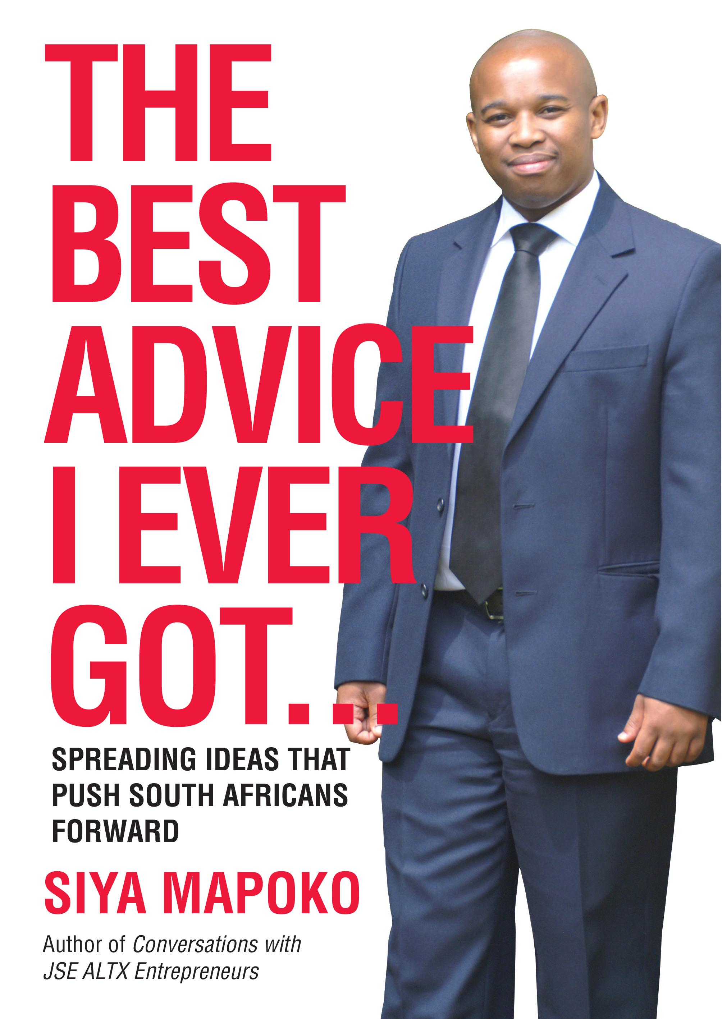
www.siyamapoko.co.za

Slide 33
GREAT NEWS
Book Giving and R100 000 for you
From R500K to R1Million!!

Slide 34
Profit School
NOW OPEN!
APPLY NOW!!!

Slide 35
Profit School
1. I want to boost my career and become one of the best-paid people in my field
2. I want to quit my job and build a lucrative business - fast!
3. I already quit my job within the last 12 months and I need help building my business fast.
4. I love my job but I also want to build a lucrative and fun side-business.
5. My business makes between R500 000 and R5 million a year and now I want fast growth and bigger profits.

Slide 36
To Get Application Details
Email Me siya@siyamapoko.com

